Slide 1
Software development Project
CSE 410
Class diagram
University of Asia Pacific Department of CSE
Course teacher : Fahad Ahmed
(Lecturer)

Slide 2
Group Members
1
2
3
Name : | Niamul Hasan
Id: | 17201026
Semester: | 4.1
Section : | A1
Name : | Tahura Nasrin
Id: | 17201031
Semester: | 4.1
Section : | A1
Name : | Md. Anik khan
Id: | 17201021
Semester: | 4.1
Section : | A1

Slide 3
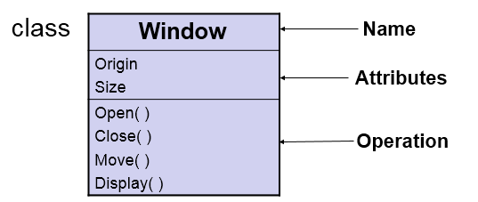
Class diagram
A class is a description of a set of objects that share the same attributes, operations, relationships and semantics.

Slide 4
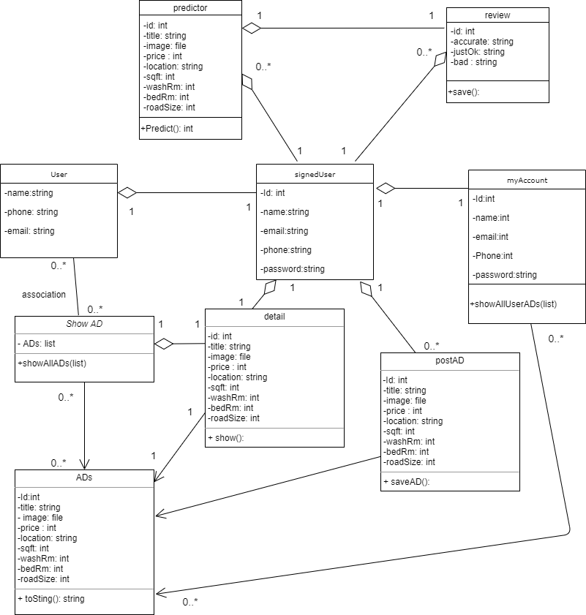
UML : Class Diagram

Slide 5
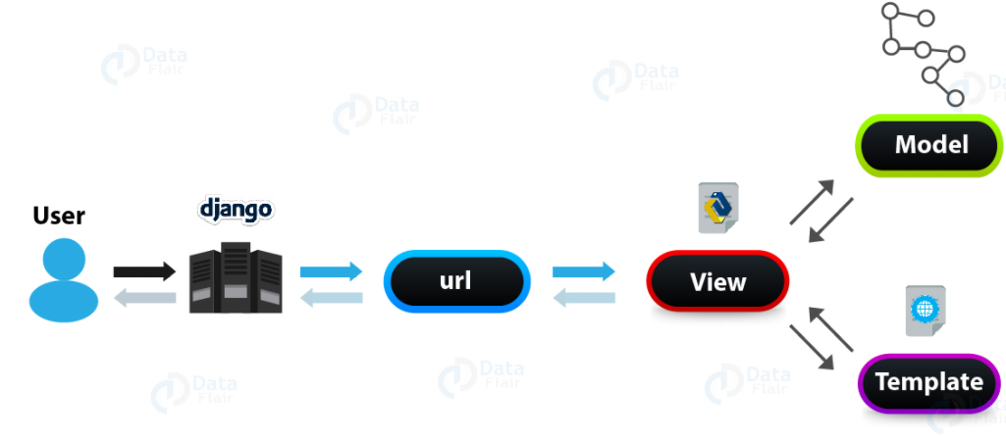
cycle of Django MVC architecture

Slide 6
Thank You
Any question?

